Slide 1

Demystifying Machine Learning

Slide 2

Hello...
About me...
A Data Science - Head with ample experience dealing with real world data analysis problems which require Machine learning and/or AI solutions
Has
I am a trainer with DevelopIntelligence, a Pluralsight Company.

Slide 3
Why study this subject?
This course aims to make participants aware about Machine Learning (ML) capabilities while demystifying the complexities around it.
This course will discuss key concepts and explain the jargons associated with ML and Artificial Intelligence (AI) in the Data Science domain.
It will help you understand the Product Life Cycle of a ML based solution.
Then the course delves into building ML models on local machines and on the AWS cloud.
Finally, the course focuses on building an end-to-end example covering training, deployment, monitoring, and maintenance of a ML Model.

Slide 4






































We teach over 400 technology topics

Slide 5



You experience our impact on a daily basis!

Slide 6
My pledge to you
I will...
Make this interactive
Ask you questions
Ensure everyone can speak
Create an inclusive learning environment
Use an on-screen timer for breaks
… also, if you have an accessibility need, please let me know

Slide 7
Objectives
At the end of this course you will:
Have knowledge about:
Machine Learning and its Use Cases
the differences in AI, ML, and DL
Various ML Algorithms
Just enough Python for ML
AI/ML Systems Taxonomy
Scalable Machine Learning on AWS
Be able to perform:
Deploy Machine Learning Pipelines in AWS

Slide 8
Agenda
High Level Introduction to Machine Learning
Just enough Python for Machine Learning
Understanding the bigger picture
Learning ML Algorithms
Performance Metrics
Scalable Machine Learning

Slide 9




What is Machine Learning?
Machine learning is a subfield of Artificial Intelligence, which is broadly defined as the capability of a machine to imitate intelligent human behavior
Machine learning allows businesses to enable the data to teach the system how to solve the problem at hand with machine learning algorithms—and how to get better over time
MIT
Google
Machine learning (ML) is the process of using mathematical models of data to help a computer learn without direct instruction
Machine learning is based on algorithms that can learn from data without relying on rules-based programming. It is considered as the sub-set of AI
Microsoft
Mckinsey

Slide 10





What is Machine Learning?
Subset of Computer Science & Artificial Intelligence
Focuses on use of data driven solutions
Imitates the way human learns
Gradually improves itself

Slide 11
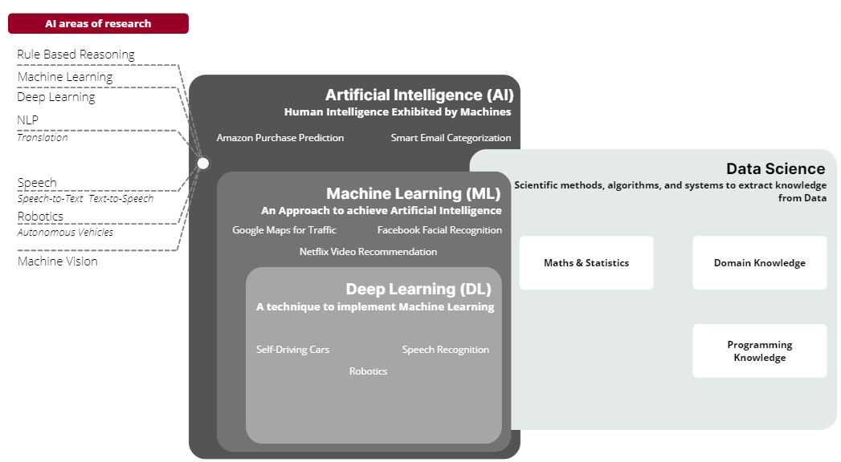
AI vs ML vs DS

Slide 12
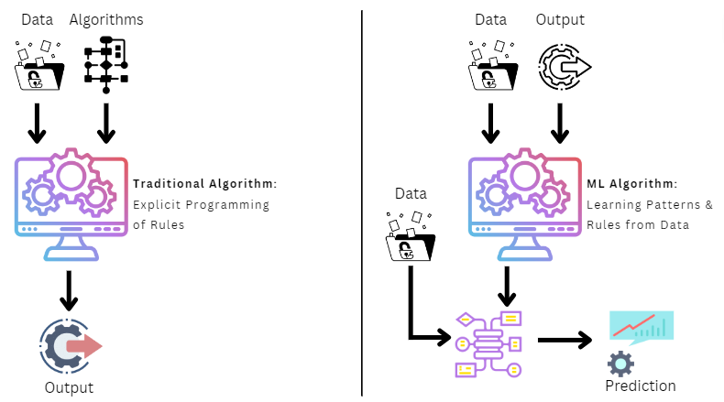
Traditional Systems vs Machine Learning Systems

Slide 13
Learning Algorithms vs Models
Learning Algorithm
Data
Set of instructions that can learn pattern from Data
Applied to
Refined Data
Produces
Model
Approximation of the reality, built using a Learning Algorithm

Slide 14
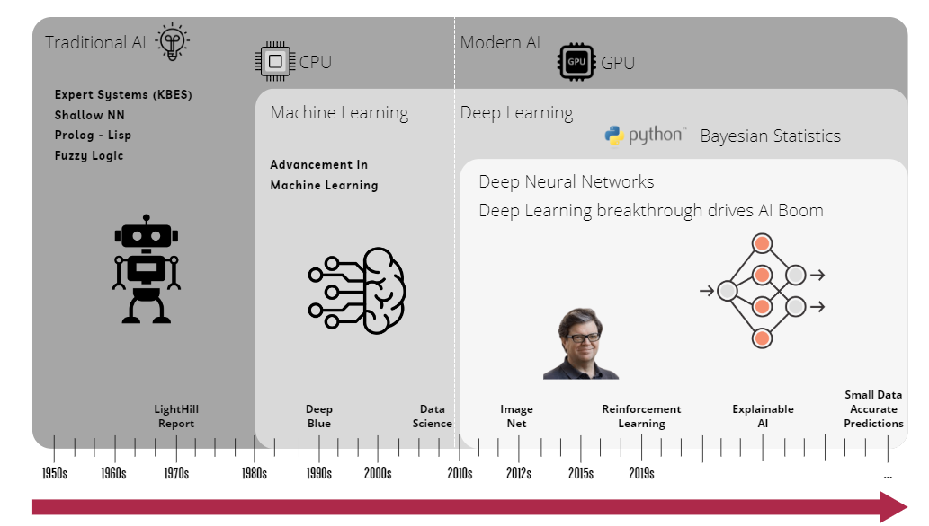
History of AI/ML System
Source: awaisbajwa.medium.com

Slide 15
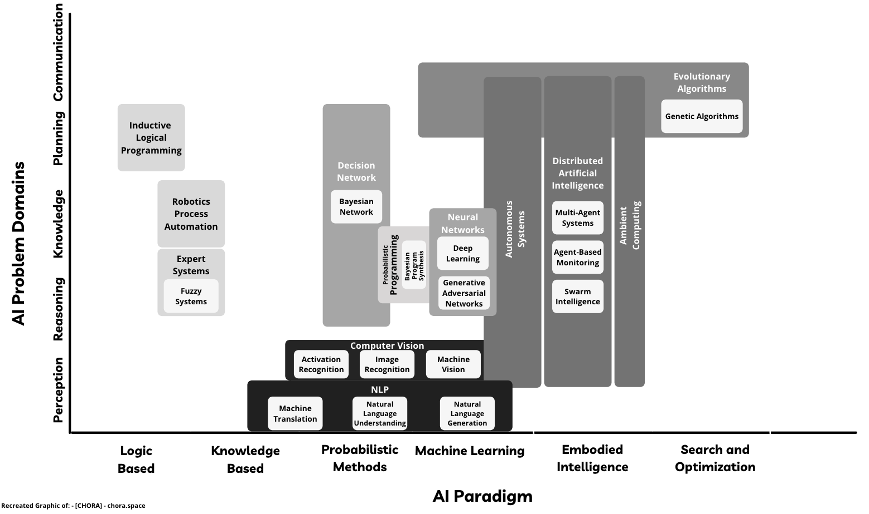
Taxonomy of AI/ML System

Slide 16

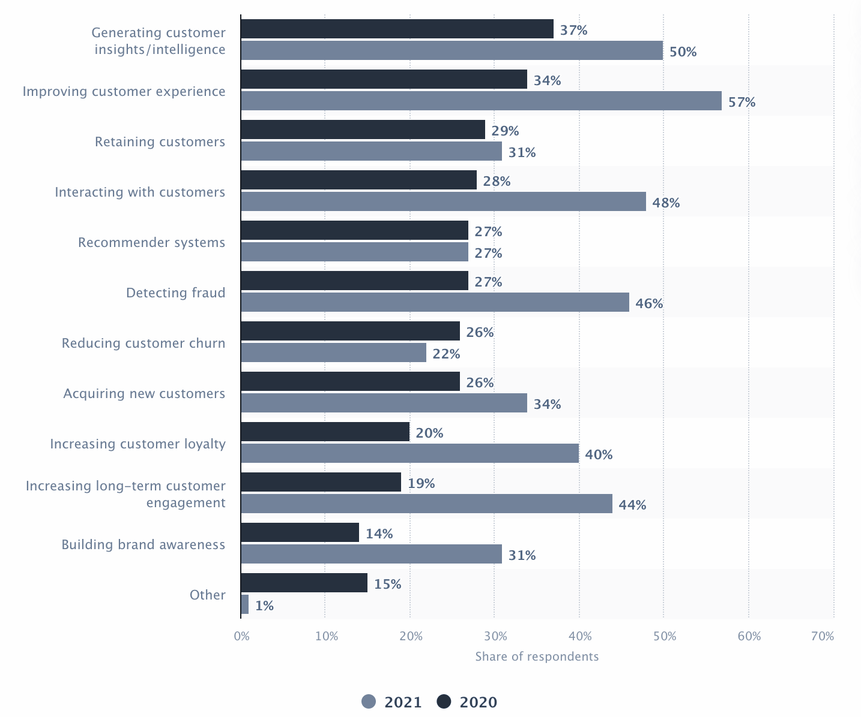






Capabilities and Use Cases
Object Detection
Speech Recognition / Sound Recognition
NLP / Sentiment Analysis
Predictions
Translation between Languages
Restoration & Transformation

Slide 17




Capabilities and Use Cases
100,000+ customers have chosen AWS for AI to improve the quality of healthcare, and more.
AWS’ pre-trained AI Services offer ready-made intelligence for your applications and workflows. Get started by powering your applications in minutes: no machine learning knowledge required.
Increase in Team Productivity
Reduction in Processing Time
Deep Learning projects have better prediction rates
Amazon Transcribe
Amazon Polly
Amazon Comprehend
Amazon Rekognition
Amazon Translate
https://ai-service-demos.go-aws.com/

Slide 18

Capabilities and Use Cases
Ham-or-Spam - An Intelligent spam filtering System
Ham-or-Spam is system which is used to classify the mails or messages or texts in two classes i.e. Ham or Spam.
According to Statista, globally 45.1% percentage of total email traffic were spam in 2021
https://ham-or-spam.herokuapp.com/

Slide 19

Capabilities and Use Cases
Artificial Intelligence can improve the process of Hiring/Recruiting significantly
Establishing a fair recruitment process
Reducing errors in recruitment Process
Enabling better assessments
Increasing the use of analytics and metrics
Making the process faster and more efficient

Slide 20
Types of Machine Learning
Machine Learning
Supervised
How it works?
Step 1. Label input data that defines output variables.
Step 2. Train the algorithm on the data to find the connection between input variables and output.
Step 3. Once training is complete, apply the algorithm to new data.
What is Supervised Learning?
An algorithm uses training data and feedback from human users to learn the relationship between given inputs and a given output

Slide 21
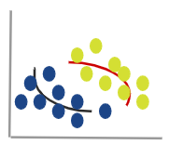
Types of Machine Learning
Machine Learning
Supervised
Unsupervised
What is Unsupervised Learning?
How it works?
It is more exploratory in nature. An algorithm explores relationships in input data without being provided an explicit output variable.
Step 1. Algorithm receives unlabeled data.
Step 2. It infers the schema from the data.
Step 3. The algorithm identifies groups of data that exhibit similar behavior.

Slide 22
Types of Machine Learning
Machine Learning
Supervised
Unsupervised
Reinforcement
What is Reinforcement Learning?
How it Works?
An algorithm learns to perform a task simply by trying to maximize the rewards it would receive for its actions.
Step 1. Algorithm takes an action affecting the environment.
Step 2. It receives a reward if the action brings the machine a step closer to max. available reward.
Step 3. The algorithm optimizes for the best series of actions by correcting itself over time.
Algorithms
STATE
ACTION
REWARD
Environment

Slide 23
Ways to perform Machine Learning
Requirements, Skillset, Compute, & Availability of Data influence the choice of approach
Less Flexible
More Flexible
Easiest Approach
Most complex Approach
Cognitive API
Auto ML
Transfer Learning
Build your own Model (BYOM)

Slide 24




Ways to perform Machine Learning
Less Flexible / Easiest Approach
More Flexible / Most complex Approach
Cognitive API
Useful when you want to use pre-built models
Make a REST-based API call to invoke it
No Machine Learning skills required
Least flexible option
Amazon Polly
Text-to-Speech API
NLP
Amazon Rekognition
Vision API
Amazon Translate
Translation API
Amazon Transcribe
Speech-to-Text API
Amazon Comprehend
NLP API

Slide 25


Ways to perform Machine Learning
Less Flexible / Easiest Approach
More Flexible / Most complex Approach
Cognitive API
Auto ML
An approach to automate Data Scientist’s work
Based on the concept “Using AI to Build AI”
No ML expertise required but correct data labeling necessary
Not much flexibility in terms of customization
Good for problems where you have an abundance of clean data and limited bandwidth of AI teams
10x
Increase in Data Science Team Productivity
54%
Less TCO compared to other clouds
Spend Time on What matters to you
AutoML for all
Full Transparency
End-to-End Solutions
Source: Amazon Sagemaker

Slide 26
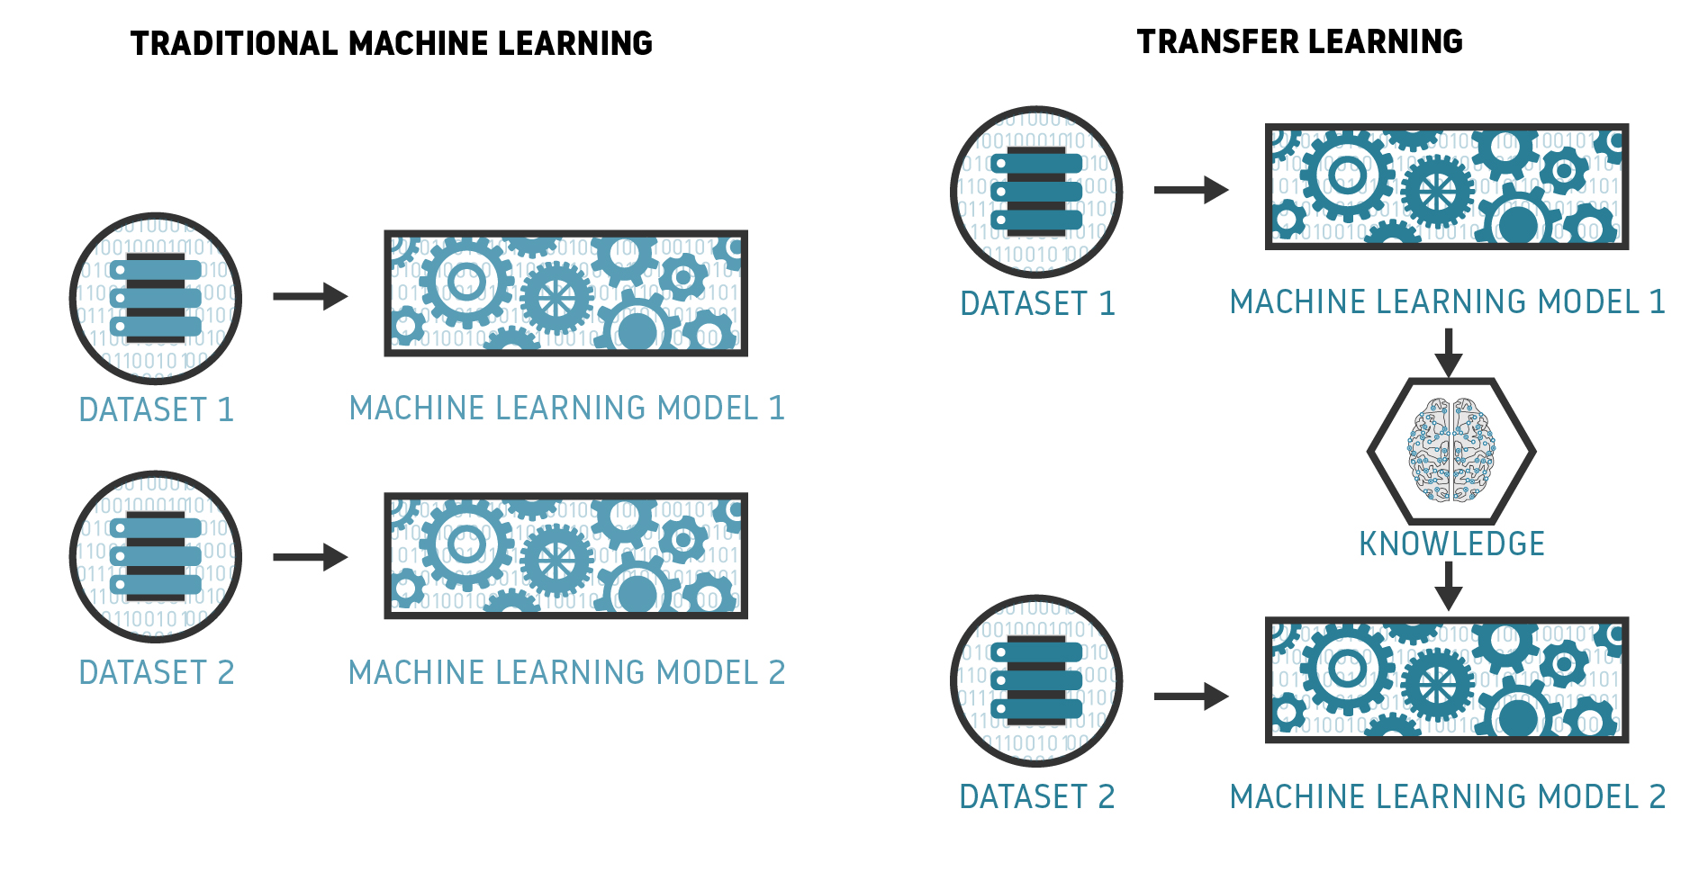
Ways to perform Machine Learning
Less Flexible / Easiest Approach
More Flexible / Most complex Approach
Cognitive API
Auto ML
Transfer Learning
Reuse experts’ knowledge
Requires Machine Learning expertise
Saves a lot of time and computational expense in model training
Provides some flexibility to fine-tune models
Requires relatively less data
TensorFlow Hub has many pre-built models
Source: bosem.in

Slide 27

Ways to perform Machine Learning
Less Flexible / Easiest Approach
More Flexible / Most complex Approach
Cognitive API
Auto ML
Transfer Learning
Bring your own Model
Most Flexible Approach
Requires Machine Learning Expertise
TensorFlow, Keras, PyTorch, etc., are the most commonly used libraries
Most used ML libraries and frameworks among developers
TensorFlow
16.53%
Keras
10.14%
PyTorch
9.89%
Apache
Spark
5.83%
Hadoop
4.43%

Slide 28
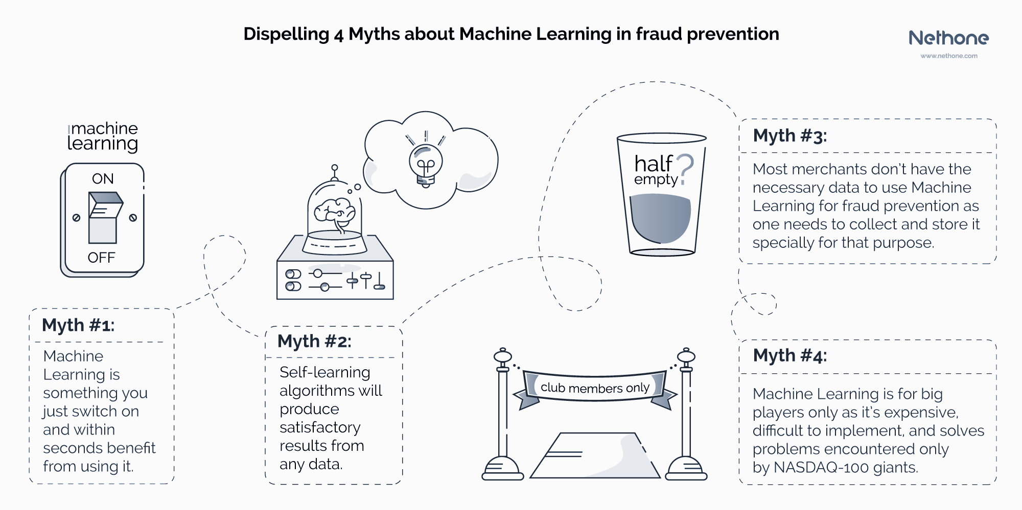
Myths around Machine Learning

Slide 29


Working with Anaconda
Anaconda is a platform for data scientists, IT professionals, and business leaders of tomorrow. It features more than 300 packages for data science.
Kernels, Data Sources, & Compute Integrations
Anaconda Enterprise automates your organization’s AI pipelines from laptops to training clusters to production clusters with ease

Slide 30

Working with Anaconda
Visit https://www.anaconda.com/distribution/
Choose the correct version and download the Anaconda platform

Slide 31
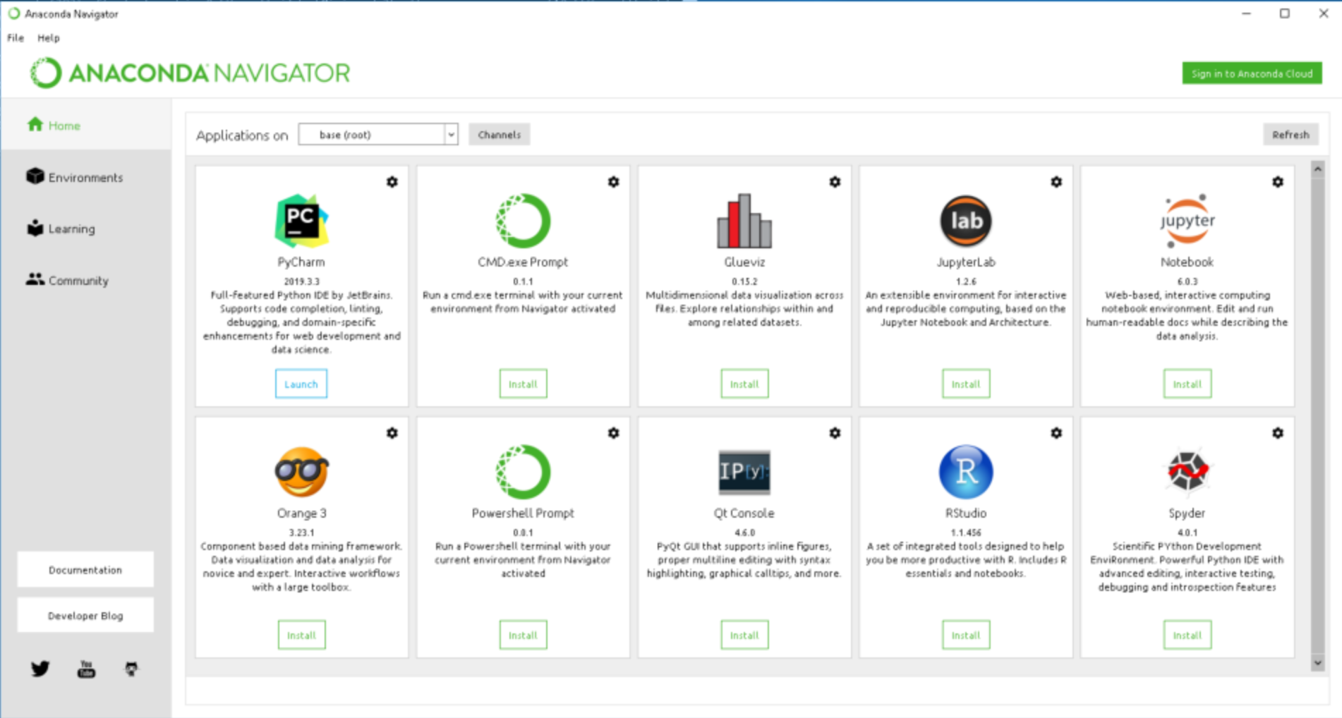
Working with Anaconda

Slide 32
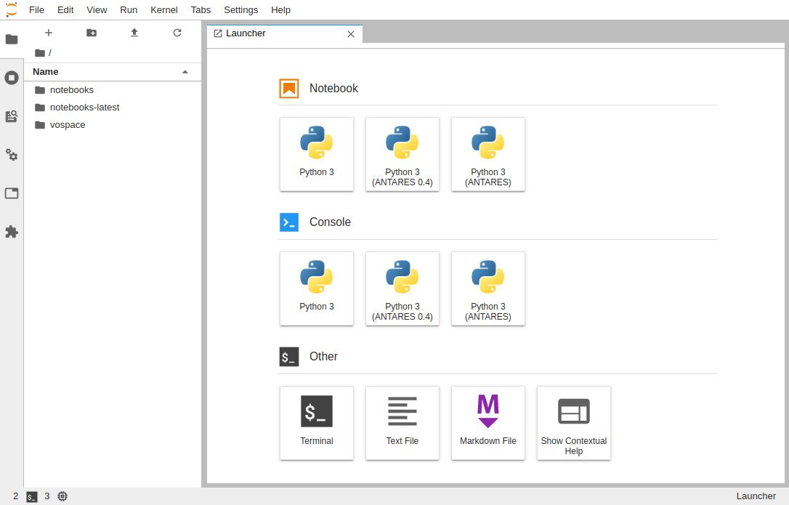
Walking through of JupyterLab Environment
JupyterLab Menu Bar
Jupyter Notebook
For interactive IDE experience
JupyterLab Options
Various options for integrating Jupyter Environment and managing kernels, tasks, & files
Jupyter Console
For Interactive CLI experience
Create New File
Create New Folder
Upload Folder/File

Slide 33
Labs
Crash Course in Plain Vanilla Python

Slide 34
Data Preprocessing Pipeline (Iterative in nature)
Data Gathering
Data Encoding
Class Imbalance
Data Exploration
Outlier Detection
Data Skew
Dimensionality Reduction
Handling Missing Data
Feature Engineering
Data Normalization
Data Filtering
Data Sorting

Slide 35
Why Visualize Data?
Here are some of the reasons :
Better Monitoring
Taking Decisions
Help Business Intelligence
Accurate Data
Finding efficiencies/inefficiencies
According to Content Marketing Institute
100,500
average words are consumed by citizens every day,
so short content help people to remember things faster
92%
consumers want brands to create ads that feel like story
60x faster
rate at which brain processes images in comparison to words

Slide 36
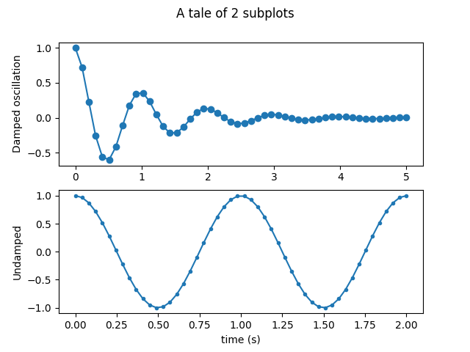
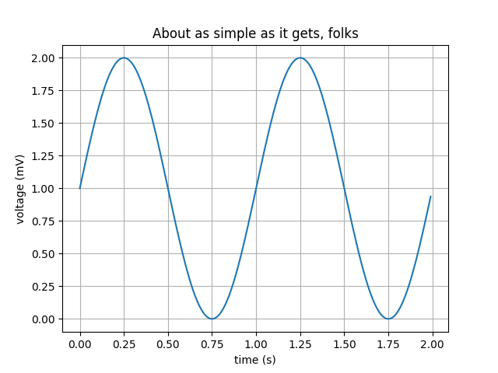
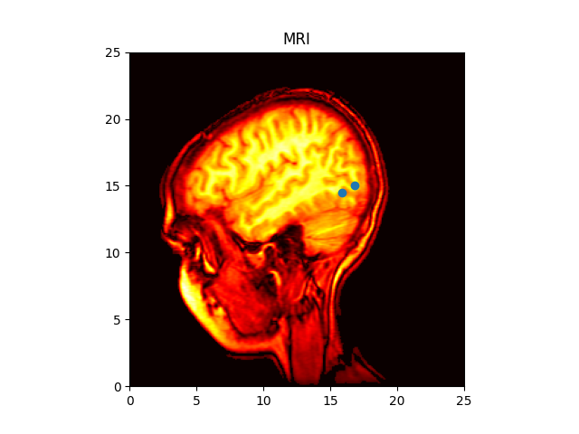
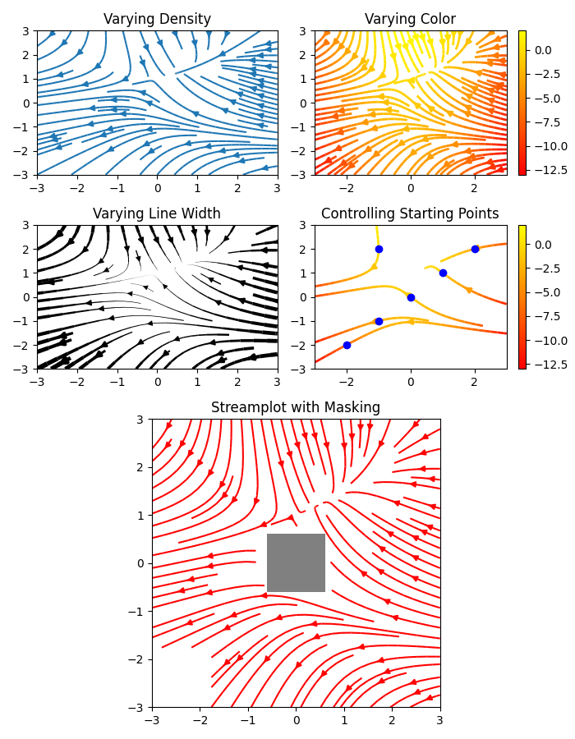
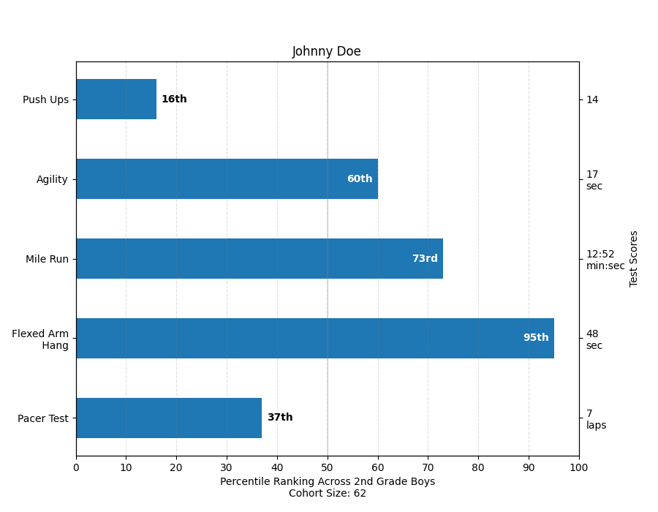
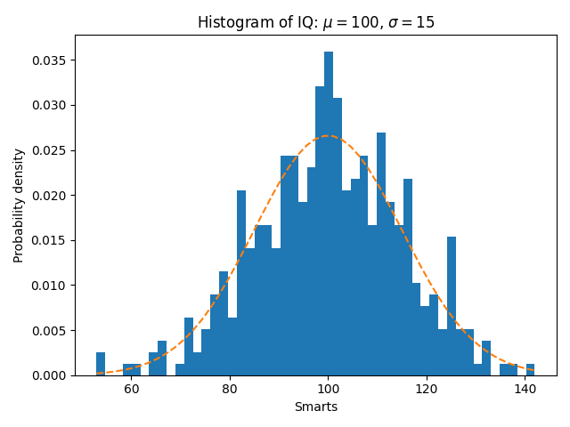
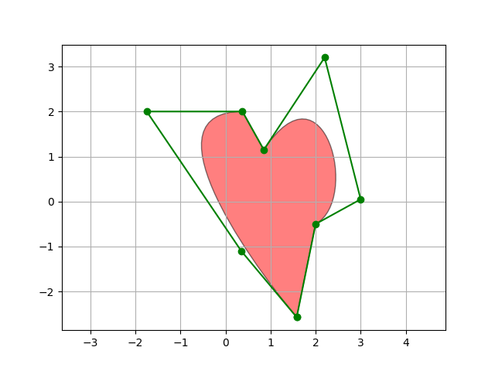
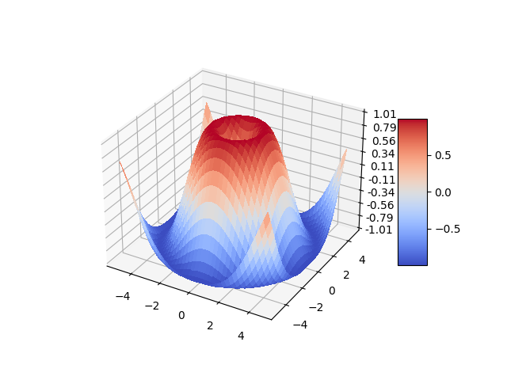
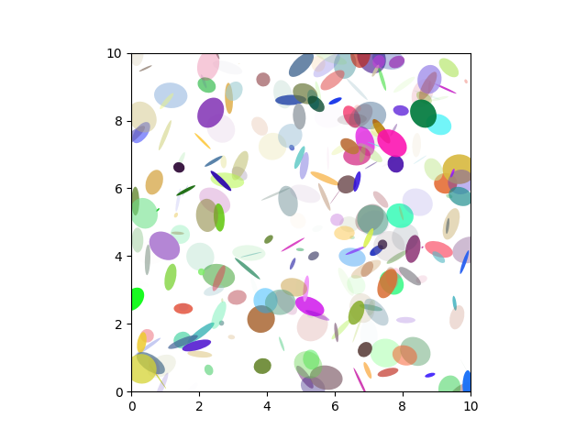
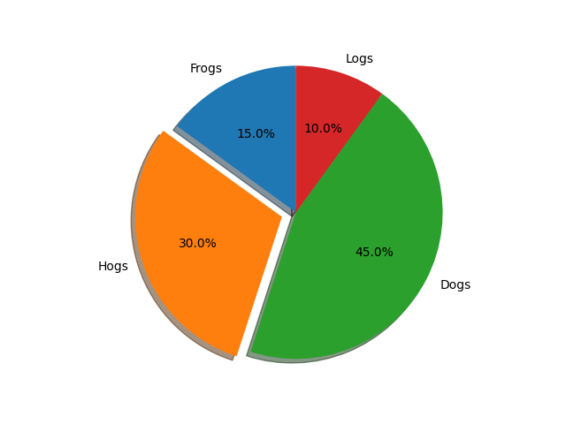
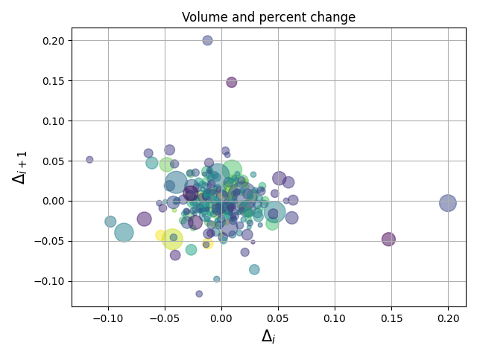
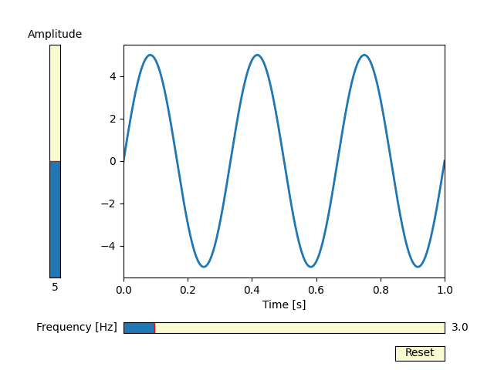
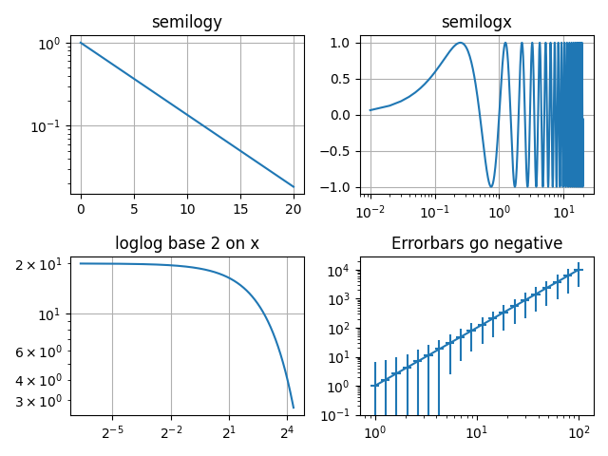
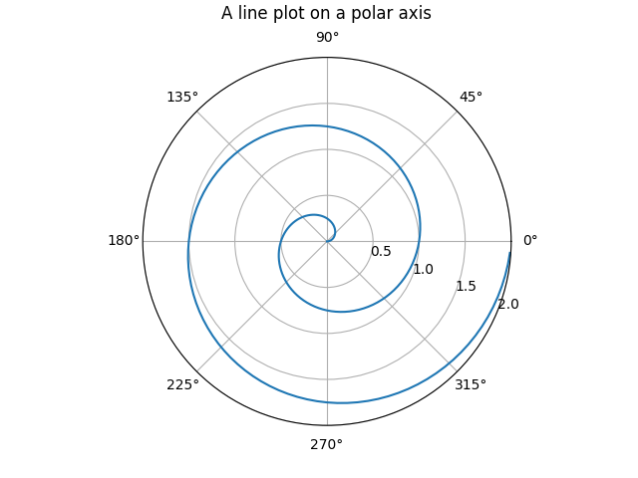
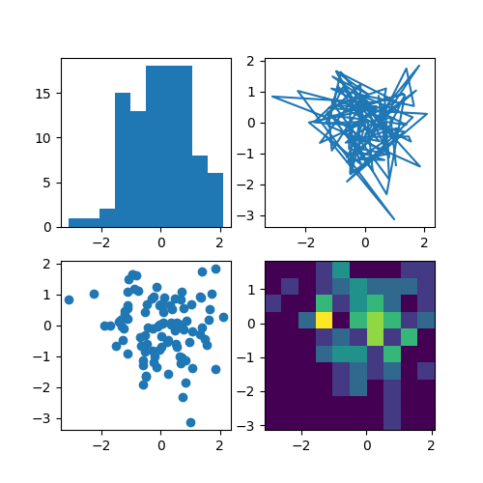
Various plots available in Python

Slide 37
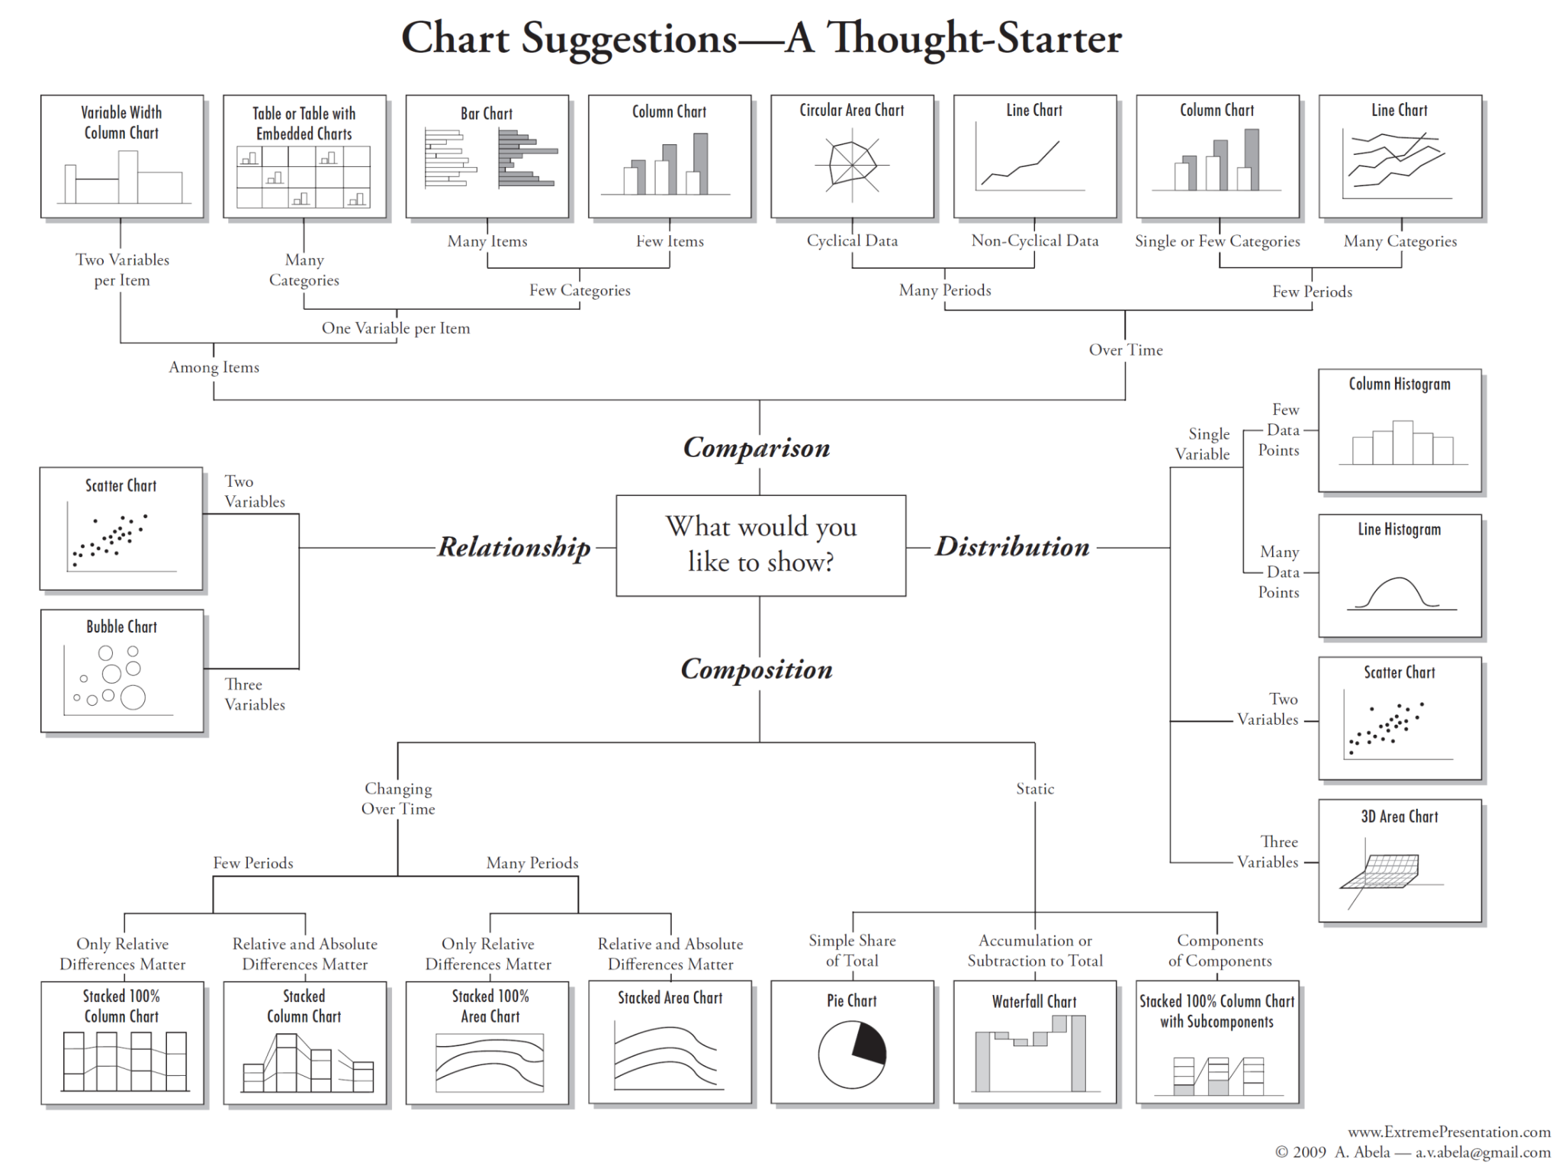
Which plot to choose when?

Slide 38
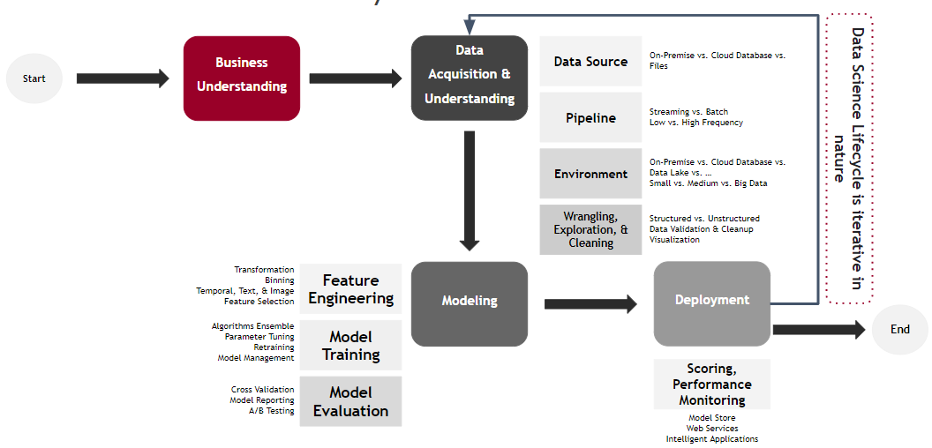
Data Science Lifecycle
Recreated graphic of: Microsoft Data Science Lifecycle

Slide 39

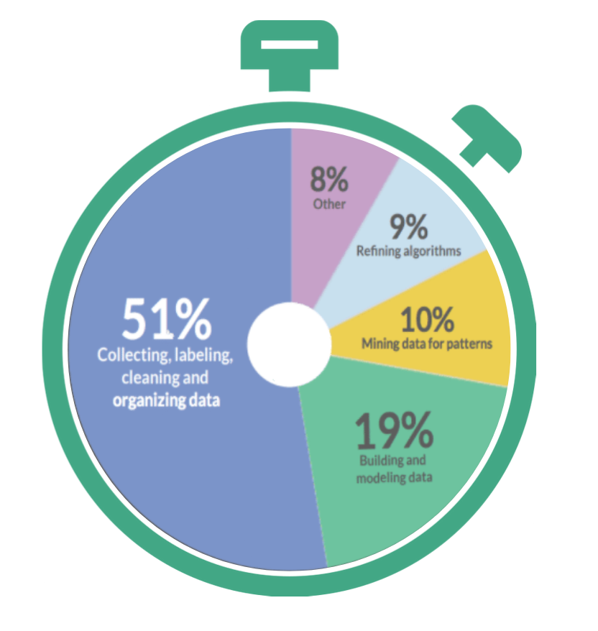
Various activities in a Data Science Project
During a Data Science project, significant time goes into Data Wrangling
What activities take the most time of Data Scientists?
Source:Hackernoon

Slide 40
Various activities in Data Science Project
A Pipeline is a standard way of implementing Machine Learning Model
Learning Model Parameters
Finding Best Hyperparameter
Data Acquisition
Data Pre-Preparation
Choose ML Models
Train ML Models
Evaluate ML Model
Model Tuning
For Example - Linear Regression, XGBoost, etc.
Deploy Model
Model Maintenance
Model Monitoring
Model Prediction
Where there is process, there are pipelines

Slide 41

Working with Scikit Learn
Simple and efficient tools for predictive data analysis
Accessible to everybody, and reusable in various contexts
Built on NumPy, SciPy, and matplotlib
Open source, commercially usable - BSD license
This ML library supports supervised and unsupervised learning
Provides tools for model fitting, data preprocessing, model selection, model evaluation, and many other utilities
Provides dozens of built-in machine learning algorithms and models, called estimators

Slide 42
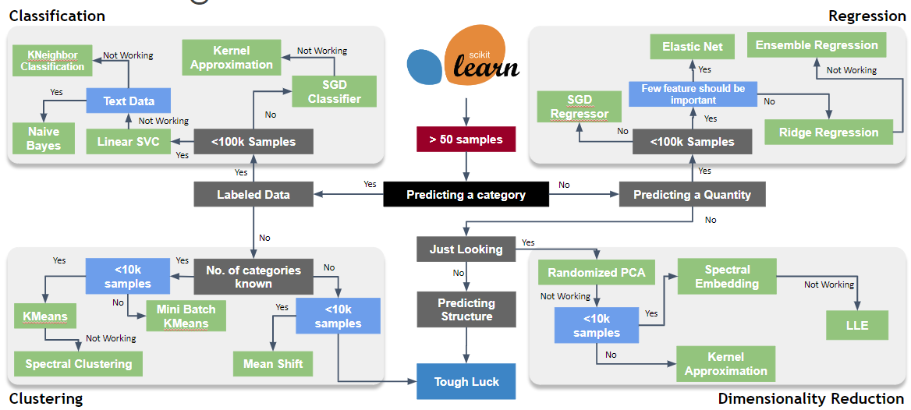
Working with Scikit Learn

Slide 43
Regression-based Algorithms
According to Oracle, Regression is a data mining function to predict a number
It predicts output labels or replies, which are continuous numeric values, for the provided input data
The model's learning from the training phase will be used to determine the output
Regression models learn precise associations between inputs and outputs using the input data features (independent variables) and their matching continuous numeric output values (dependent or outcome variables)

Slide 44
Regression based Algorithms
Generalized LInear Models
Linear
Lasso
Logistic
Multivariate
Multiple
Salary forecasting
Traffic forecasting
Enterprise wide risk framework
Analyze multiple stress scenarios
Predict House Prices
Customer Lifetime value
Best product combinations for retailers
Behavioural Analysis
Insurance Claim Worthiness

Slide 45
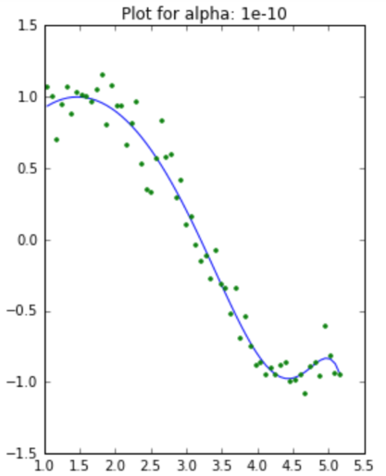
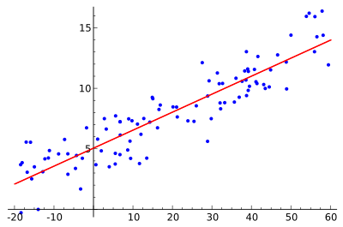
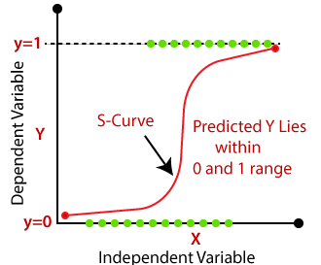
Regression based Algorithms
Linear
Lasso
Logistic

Slide 46
Tree-based Algorithms
One of the greatest and most popular supervised learning techniques is based on tree-based algorithms
Predictive models are strengthened by tree-based algorithms because of their excellent accuracy, stability, and simplicity
They can adjust to any situation and find a solution to any issue (classification or regression)
In many types of data science challenges, tree-based techniques including gradient boosting, random forest, and decision trees are frequently used

Slide 47
Tree based Algorithm - Types
Decision Tree
A graphical representation of possible solutions to decision based on certain conditions
Bagging
Ensemble meta-algorithm combining predictions from multiple decision trees through a majority voting mechanism
Random Forest
Bagging based algorithm where only a subset of features are selected at random to build a forest or collection of decision trees
Boosting
Models are build sequentially by minimizing the errors from previous models while increasing influence of high performing models
Gradient Boosting
Employs gradient descent algorithms to minimize errors in sequential models
XGBoost
Optimized gradient boosting algorithm through parallel processing, tree pruning, handling missing values & regularization to avoid overfitting/bias

Slide 48
Instance-based Algorithms
Instance-based learning is a family of learning algorithms that compares new issue instances with cases seen during training that have been retained in memory, as opposed to conducting explicit generalization
These algorithms are commonly referred to as "lazy" since computation is delayed until a new instance is observed
It is called instance-based because it constructs hypotheses directly from the training instances themselve
Examples of instance-based learning algorithms are the K-nearest neighbors (KNN) algorithm, Kernel Machines and RBF networks

Slide 49
Instance based Algorithm - Types
Types of Instance based Algorithms
K Nearest Neighbour
Self Organizing Map
Learning Vector Quantization
Locally Weighted Learning

Slide 50
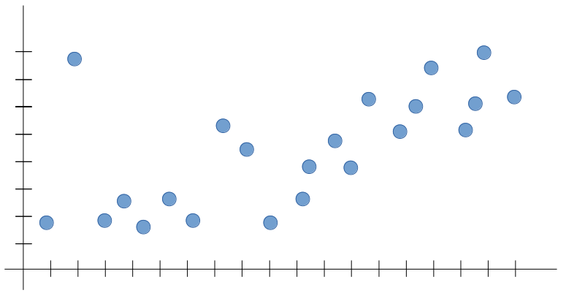
Bias vs Variance
Let’s say we’re trying to build a Machine Learning model for the following data set

Slide 51
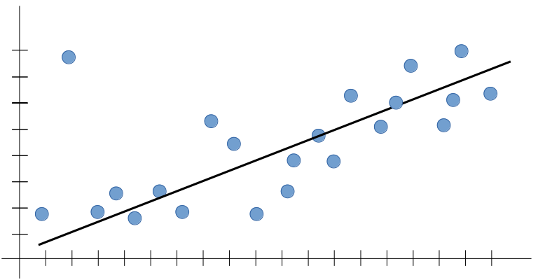
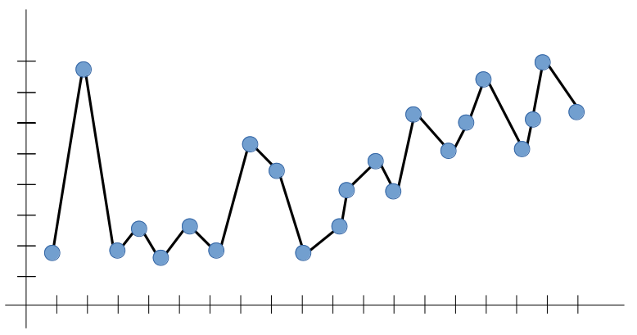
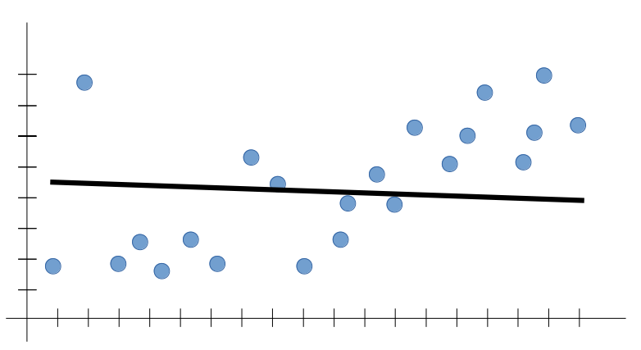
Bias vs Variance
A Good-Fit Model
Overfitting Model
Underfitting Model
In terms of Machine Learning, the line above could give a very likely prediction for any new input, The outputs are expected to follow the trend seen in the training set
Overfitting is the case where the overall cost is really small, but the generalization of the model is unreliable. This is due to the model having “learned too much” from the training data set
Underfitting is the case where the model has “not learned enough” from the training data, resulting in low-levels of generalization and unreliable predictions

Slide 52
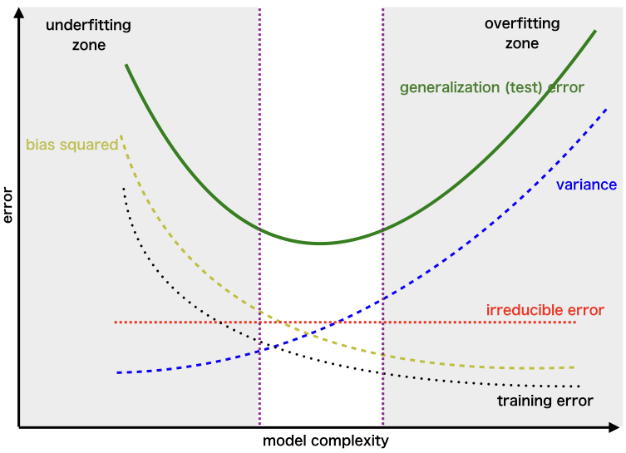
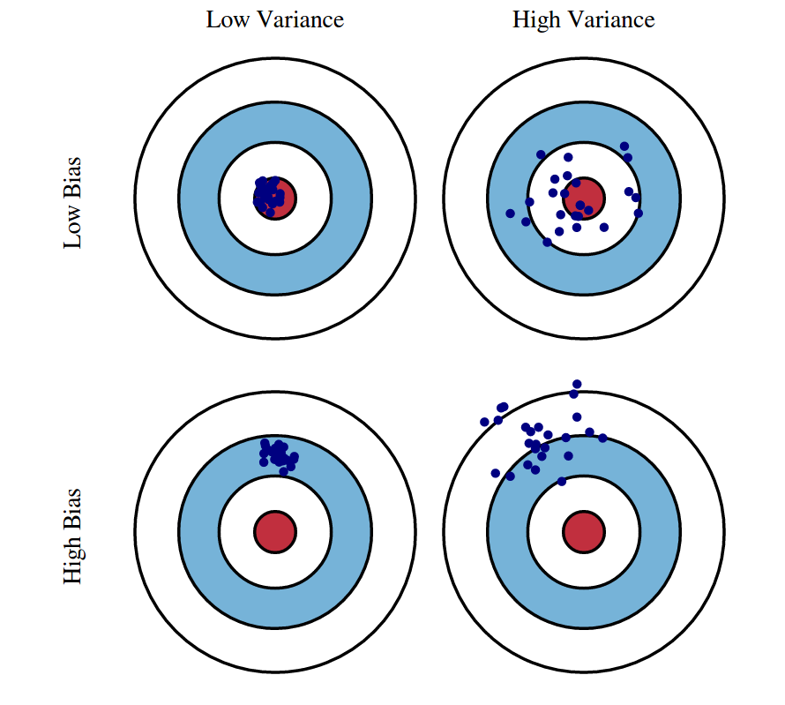
Bias vs Variance
Underfitting
Overfitting

Slide 53
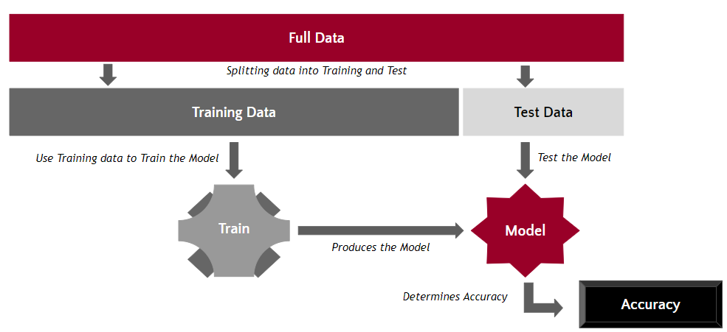
Data Splitting & its Importance
If we use all the data for training then we do not have any way of evaluating the model performance

Slide 54

Evaluation Metrics: Is Accuracy Enough?
A system has to specify we have Dog or Not Dog within a set of pictures
One of the simple evaluation metrics is accuracy. Suppose you have 5 images and the model gets 4 of them right, then the score is 0.8
Thus, we can say accuracy is the number of correctly classified images over total images. That is simple and intuitive, but this is not enough

Slide 55
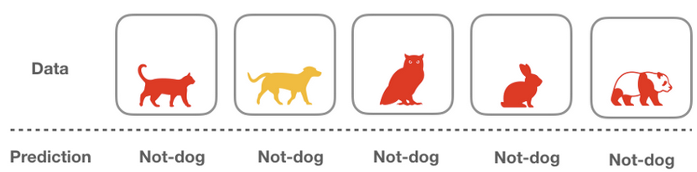
Evaluation Metrics: Is Accuracy Enough?
Let’s create an algorithm
def is_a_dog (x):
return False
The naive algorithm above assumes everything is not a dog without doing any computation on the given data
One thing to notice is that because coincidentally our dataset has 4 images that are not-dog, such naive algorithm gets the score of 0.8 (so called accuracy)

Slide 56
Evaluation Metrics: Is Accuracy Enough?
Here we are having the Class Imbalance Problem
It will lead you to failure of Accuracy

Slide 57
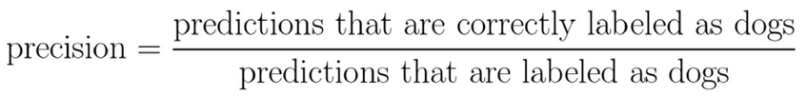

Evaluation Metrics: Other metrics to look for
Ways to combat this situation:
Precision: Among all of the predictions that are “dog”, how many of them are correctly classified?
Recall: Among all of data that are labelled “dog”, how many of them are correctly classified?

Slide 58

Evaluation Metrics: Other metrics to look for
At Airport, What is required? Accuracy or Precision?

Slide 59

Evaluation Metrics: Other metrics to look for
In Courtroom, What is required? Accuracy or Precision?

Slide 60
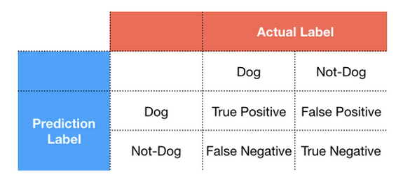
Evaluation Metrics: Other metrics to look for
Let’s create a Confusion Matrix
A Confusion matrix splits the data into 4 categories: true positive, true negative, false positive and false negative

Slide 61
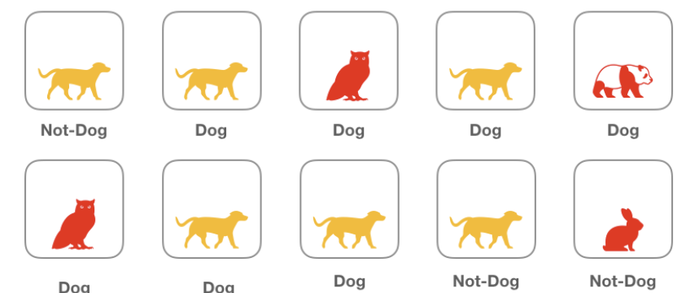
Evaluation Metrics: Other metrics to look for
Let’s consider a batch of images labelled as Dog and Not-Dog:

Slide 62
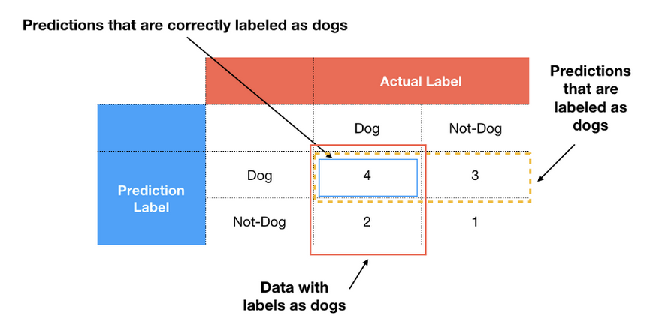
Evaluation Metrics: Other metrics to look for
Now evaluate it using Confusion Matrix
In this case, the Precision is (4/(4+3))= 0.57 whereas recall is (4/(4+2))= 0.66

Slide 63
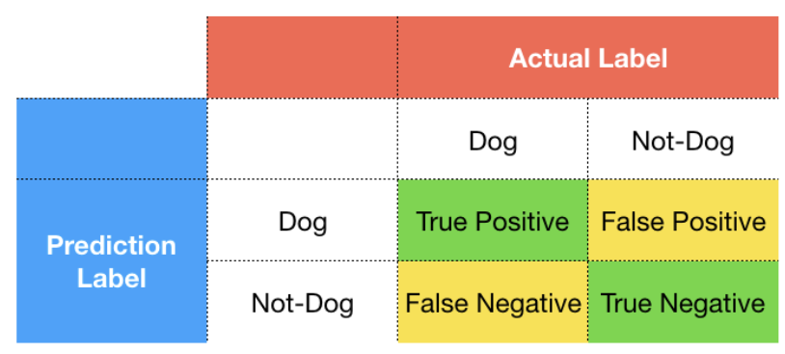
Evaluation Metrics: Other metrics to look for
How to decide Precision or Recall?

Slide 64
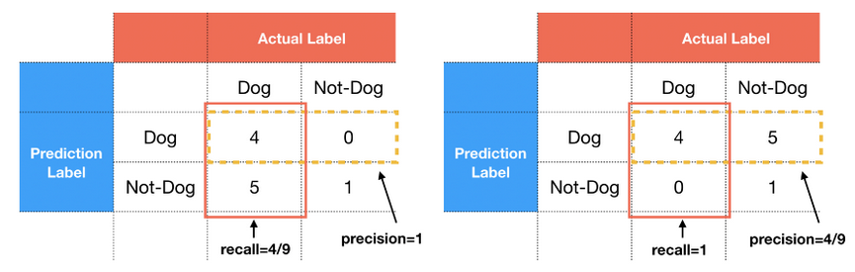
Evaluation Metrics: Other metrics to look for
Suppose our model will surely have 5 incorrect labels, if all the incorrect classifications fall into false-positive, then we will have low precision and high recall
However, if the incorrect labels fall into false-negative, we will instead have high precision and low recall

Slide 65
Evaluation Metrics: Other metrics to look for
Therefore, when you train your machine learning model, you must decide which metrics is more important.
If we were asked to build a model for financial institution where we want to classify whether the borrower is a good candidate or not, we may prefer our model not to give the loan recklessly
Therefore, we rather classify the good people as bad people (false negative) rather than to classify the bad people as good one (false positive)
In other word, false negatives (high recall) is more preferable than the false positives (high precision)

Slide 66
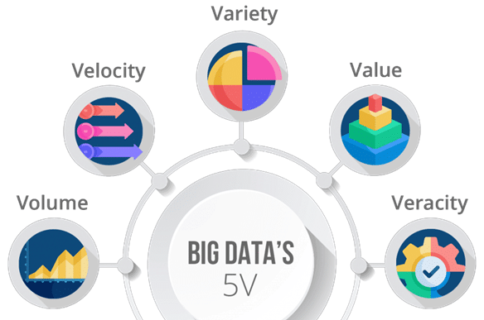
Big Data and its Significance
Big Data is a collection of data that is huge in volume and growing exponentially, as well as one that does not fit within the traditional storage methods of traditional data management tools

Slide 67
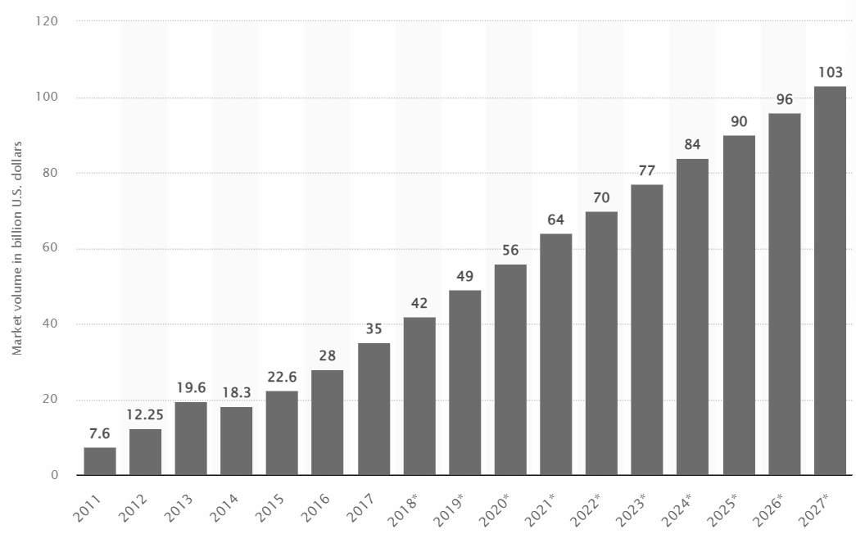
Big Data and its Significance
According to Statista, Big data market size revenue forecast worldwide from 2011 to 2027

Slide 68
Significance of Big Data for Machine Learning
72% of business leaders say AI will bring a Business Advantage
85% of Customer Interaction would be managed without humans by 2022
1 billion video cameras would be connected to AI by 2022
4 billion devices currently in use includes AI voice capabilities
$15.7 Trillion will be added to economy by 2030 from AI Productivity and Personalizations
2.3 million jobs created from AI while 1.8 million eliminated by 2022

Slide 69
Significance of Big Data for Machine Learning
Machine Learning provides efficient and automated tools for data gathering, analysis, and assimilation
With cloud computing scale, you can ingest large amounts of data, regardless of its source, into your ML pipelines
Machine learning algorithms can be applied to every element of Big Data operations including:
Data Segmentation
Data Analytics
Simulation

Slide 70
Recalling the General Machine Learning Pipeline
Learning Model Parameters
Finding Best Hyperparameter
Data Acquisition
Data Pre-Preparation
Choose ML Models
Train ML Models
Evaluate ML Model
Model Tuning
Model Deploy
Model Maintenance
Model Monitoring
Model Prediction

Slide 71





Machine Learning Pipeline on AWS
AWS LAMBDA
AWS GLUE ETL
AWS SAGEMAKER
TRAINING JOBS
Data Acquisition
Data Pre-Preparation
Choose ML Models
Train ML Models
Evaluate ML Model
Model Tuning
Model Deploy
AWS SAGEMAKER
MODEL ARTIFACT BUCKET
Model Maintenance
Model Monitoring
Model Prediction

Slide 72
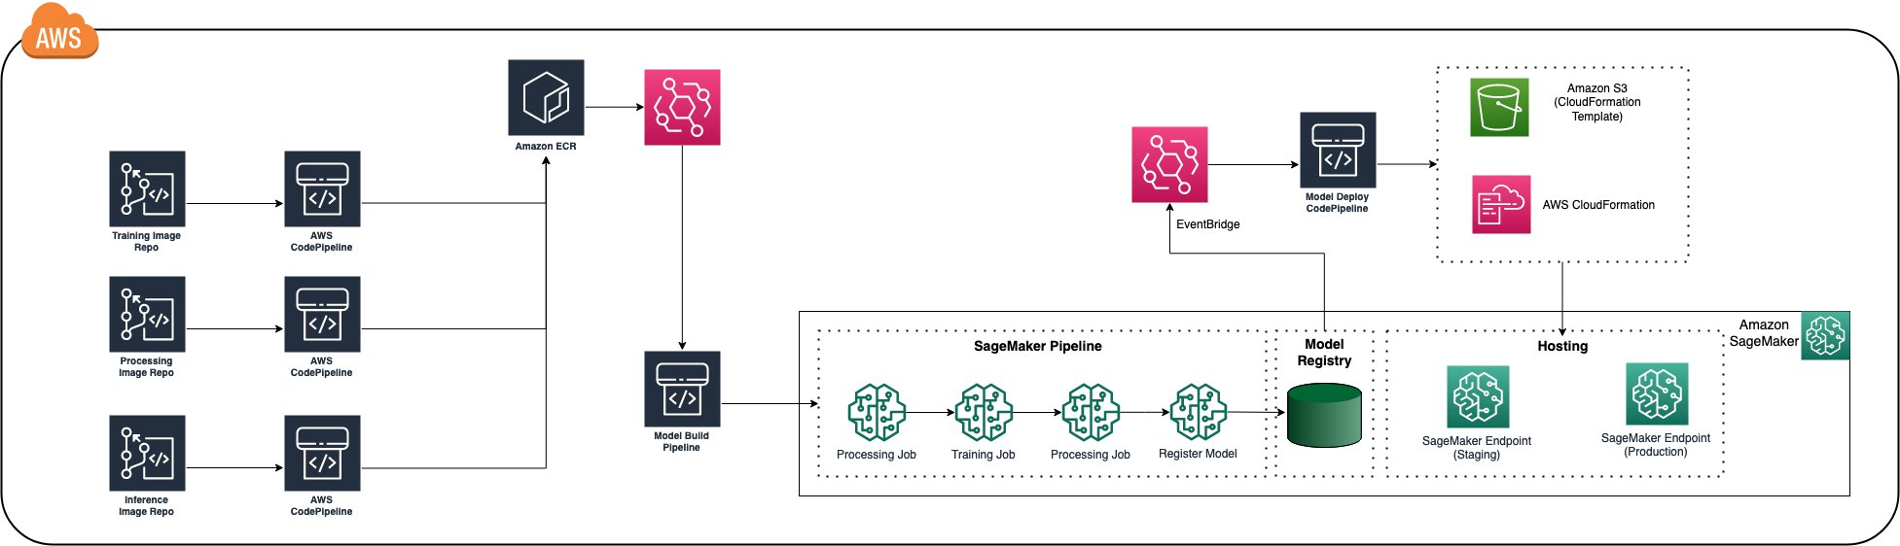
Machine Learning Pipeline on AWS Sagemaker

Slide 73
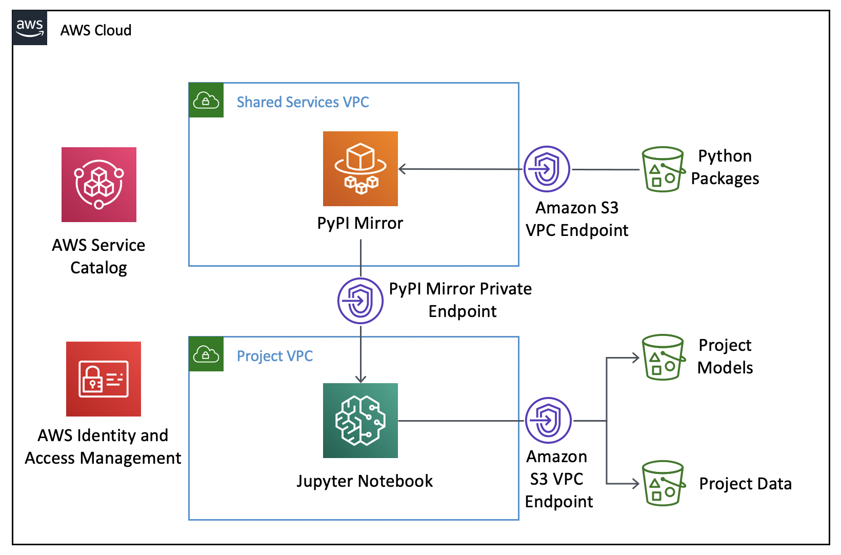
Security Aspect in Machine Learning Projects

Slide 74
Demo
Building end-to-end ML Pipeline on AWS SageMaker

Slide 75




Appendix

Slide 76
Skills of the Future Cloud
Chief Security Office
Overview of Barclays Private Cloud Computing
September 21st , 2022

Slide 77
Different types of hosting environments (Private Cloud)
BCP
BVP
eBCP
eBVP

Slide 78


Barclays Virtual Platform (BVP)
Lifecycle Automation
vRA8
VMware Cloud Foundation
EMEA
Northolt
Slough
Gloucester
APAC
SDC1
SDC2
HK5
AMER
Piscataway
Cranford
Image source: https://27virtual.com/solutions/automation/

Slide 79


Barclays Container Platform (BCP)
Lifecycle Automation
Network Orchestration
Red Hat OpenShift Container Platform
EMEA
Northolt
Slough
Gloucester
AMER
Piscataway
Cranford
https://www.redhat.com/en/technologies/cloud-computing/openshift/what-are-openshift-operators

Slide 80
What does “e” stand for?
eChannels is the front line of defence against malicious attack from third party actors
Internet
A1
Internet Connectivity Layer
A2
Load balancing
A4
Reverse Proxy
A6
Application Server
CIPE
The Internal Network
eChannels is a DMZ composed of multiple Zones and technologies segregated by firewalls

Slide 81

Skylight - Private Cloud management

Slide 82


Future of Automation Private Cloud
BVP
eBCP
BCP
eBVP

Slide 83
Useful Links
BVP & eBVP Private Cloud Knowledge Base
https://confluence.barcapint.com/x/sARBS
BCP & eBCP Private Cloud Knowledge Base
https://confluence.barcapint.com/x/lDFiIQ

Slide 84


Barclays Multi Cloud Targets (Public Cloud)

Slide 85
Barclays AWS Account Types
Foundation
(Closing down)
Barclays Landing Zone (BLZ)
Internet Facing Environment (IFE)
Limited range of AWS services
Wider range of AWS services
Pre-defined patterns
AWS Service Catalog
Curated Approach
No connectivity to Campus network
Compliance shared model
Phasing out
Preferred target for AWS Public Cloud workload
Curated Approach

Slide 86
Barclays AWS Account Types – Services Comparison
Foundation
(Closing down)
Barclays Landing Zone (BLZ)
Internet Facing Environment (IFE)
EC2 (AutoScaling)
ECS
ASM
ACM
S3
Elasticache
EC2
ECS
S3
RDS
EC2
ECS
EKS
CloudFormation
ServiceCatalog
ASM
ACM
RDS
DynamoDB
Elasticache
+ More

Slide 87
Barclays Azure Account Type
Azure Landing Zone
(AZLAN)
Virtual Desktop Workload
Azure Red Hat OpenShift (ARO)
Microsoft Native Services

Slide 88

AWS Account Access – Barclays AWS Portal

Slide 89

Azure Subscription Access

Slide 90
Future of Automation Public Cloud
BLZ
IFE
AZLAN

Slide 91
Useful Links
Public Cloud Knowledge Base
https://now.barclays.com/WCP/content/bncontent/sites/en/publiccloud/home.html

Slide 92

Quiz time
www.menti.com (code 19 13 27)

Slide 93
Thank You

